Slide 1




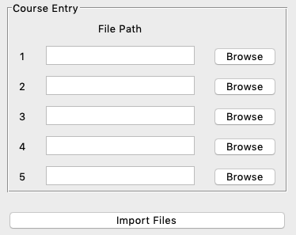


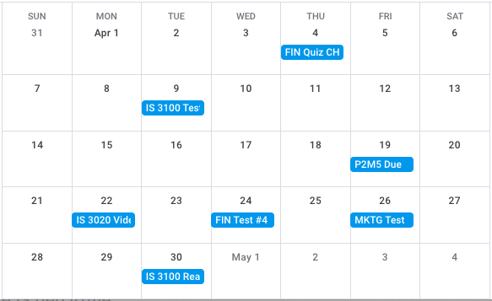
Class Coordinator
Step 3
User can switch between List and Calendar views of all coursework for the semester
By Zach Cory
Overview
Tech Stack
Class Coordinator automatically extracts and organizes assignments from your syllabus, allowing you to organize your semester with a few clicks
List View
Calendar View
Class | Assignment | Due Date
FIN 3100 | Quiz Ch 12 | 4/4
IS 3100 | Test #2 | 4/9
IS 3020 | P2M5 | 4/19
IS 3020 | Video Quiz | 4/22
FIN 3100 | Test #4 | 4/24
MKTG 3100 | Exam 3 | 4/26
Step 1
Insert Each Class Syllabus PDF
List View
Calendar View
Step 2 Each Syllabus is analyzed by OpenAI. Then the assignment data is exported to Google Sheets and Google Calendar
GitHub Repository:
https://github.com/ksu-is/Class-Coordinator

